Slide 1
Hadoop/Spark Tutorial
Yao-Chung Fan
yfan@nchu.edu.tw
National Chung Hsing University

Slide 2

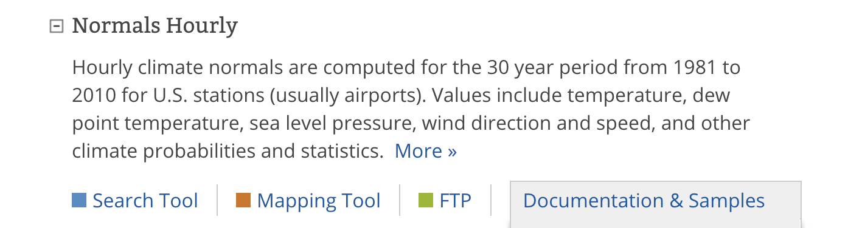
作業 1
計算歷史最高溫
Download Link:
ftp://ftp.ncdc.noaa.gov/pub/data/normals/1981-2010/ 15TB
繳交期限：Due 09/30

Slide 3
Project Challenge
Hardware Limitations
Performance Consideration

Slide 4
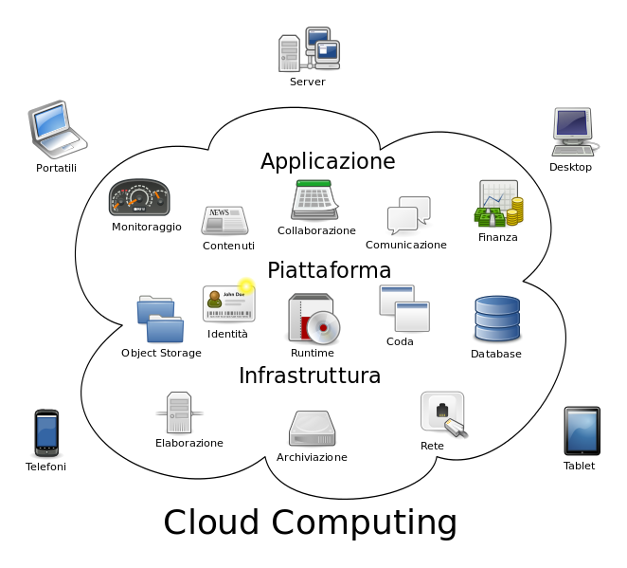
What is cloud computing?

Slide 5
Assignment Challenge
Hardware Limitations
could be solved by applying a credit card ?
Performance Consideration
Employing parallel programming model ?

Slide 6
Divide and Conquer
200G
200G
200G
200G
200G
1TB

Slide 7
Current Tools
Parallel Programming models
Shared memory (Java Threads)
Message passing interface (MPI)
Message Passing
Shared Memory
Memory
P₁
P₂
P₃
P₄
P₅
P₁
P₂
P₃
P₄
P₅

Slide 8
Managing Multiple Workers
Difficult because
We don’t know the order in which workers run
We don’t know when workers interrupt each other
We don’t know the order in which workers access shared data
Thus, we need:
Semaphores (lock, unlock)
Conditional variables (wait, notify, broadcast)
Still, lots of problems:
Deadlock, livelock, …

Slide 9
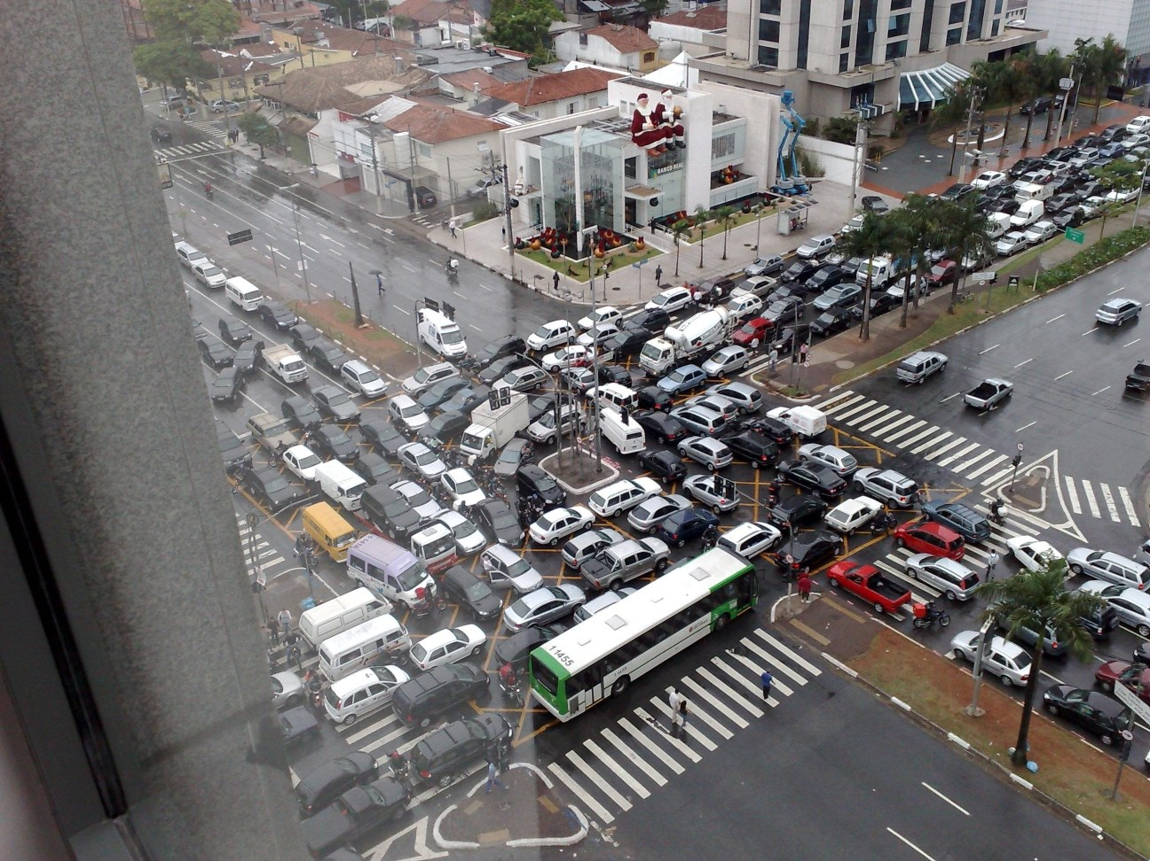
Source: Ricardo Guimarães Herrmann

Slide 10

MapReduce

Slide 11
What’s the point?
Hide system-level details from the developers
Using Commodity Machines to Scale up the power !

Slide 12
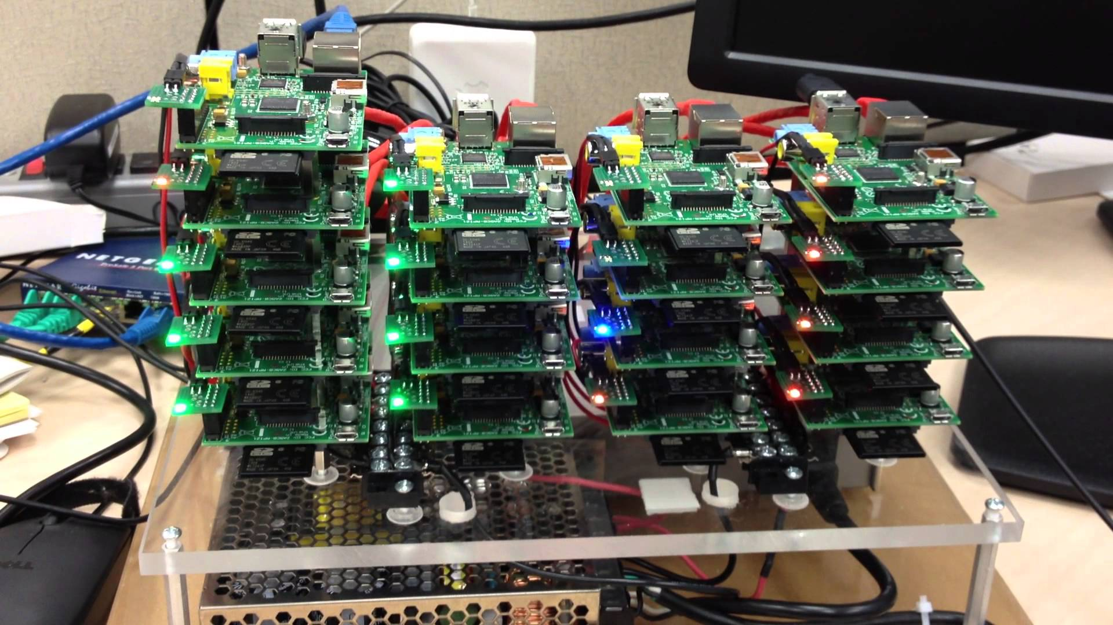

Slide 13
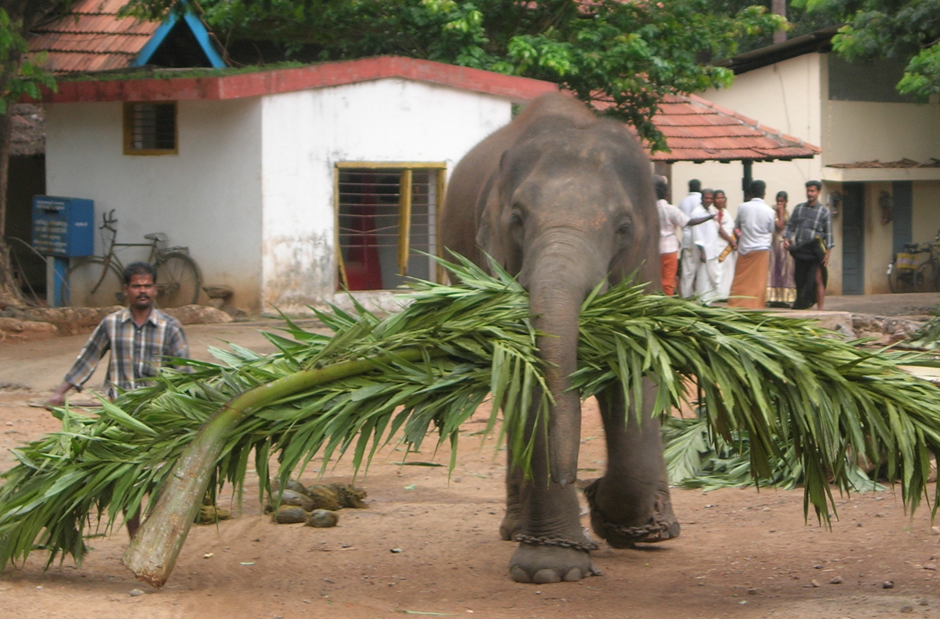
MapReduce
Source: Wikipedia (Mahout)

Slide 14
What is MapReduce?
Parallel programming model for clusters of commodity machines
Platform for reliable, scalable parallel computing
Abstracts issues of parallel environment from programmer.

Slide 15
MapReduce Implementations
Google has a proprietary implementation in C++
Bindings in Java, Python
Hadoop is an open-source implementation in Java
Development led by Yahoo, used in production
Now an Apache project
Rapidly expanding software ecosystem

Slide 16
Introduction to Hadoop
Apache Hadoop
Open Source – Apache Foundation project
Apache Platinum Sponsor
History
Started in 2005 by Doug Cutting
Yahoo! became the primary contributor in 2006
Portable
Written in Java
Runs on commodity hardware
Linux, Mac OS/X, Windows, and Solaris

Slide 17
A short history
Google’s GFS & MapReduce papers published:
SOSP 2003 : “The Google File System”
OSDI 2004 : “MapReduce : Simplifed Data Processing on Large Cluster”
OSDI 2006 : “Bigtable: A Distributed Storage System for Structured Data”
http://research.google.com/pubs/papers.html

Slide 18


A short history
Dong Cutting
Hired by Yahoo at 2006
Hadoop

Slide 19


Growing Hadoop Ecosystem
Hadoop Core
Distributed File System
MapReduce Framework
Pig (initiated by Yahoo!)
Parallel Programming Language and Runtime
Hbase (initiated by Powerset)
Table storage for semi-structured data
Zookeeper (initiated by Yahoo!)
Coordinating distributed systems
Hive (initiated by Facebook)
SQL-like query language and metastore

Slide 20


Hadoop Workflow
Hadoop Cluster
You

Slide 21
Hadoop Workflow
1. Load data into HDFS
Hadoop Cluster
You

Slide 22
Hadoop Workflow
1. Load data into HDFS
2. Develop code locally
Hadoop Cluster
You

Slide 23
Hadoop Workflow
1. Load data into HDFS
2. Develop code locally
3. Submit MapReduce job
Hadoop Cluster
You

Slide 24
Hadoop Workflow
1. Load data into HDFS
2. Develop code locally
3. Submit MapReduce job
Hadoop Cluster
You
4. Retrieve data from HDFS

Slide 25
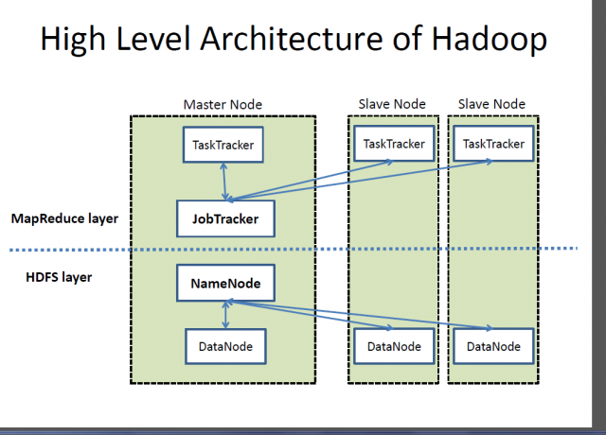
Hadoop Architecture

Slide 26
Apache Hadoop – key components
Hadoop Common: Common utilities
(Storage Component) Hadoop Distributed File System (HDFS): A distributed file system that provides high-throughput access
(Scheduling) Hadoop YARN: A framework for job scheduling and cluster resource management
(Processing) Hadoop MapReduce (MR2): A YARN-based system for parallel processing of large data sets

Slide 27
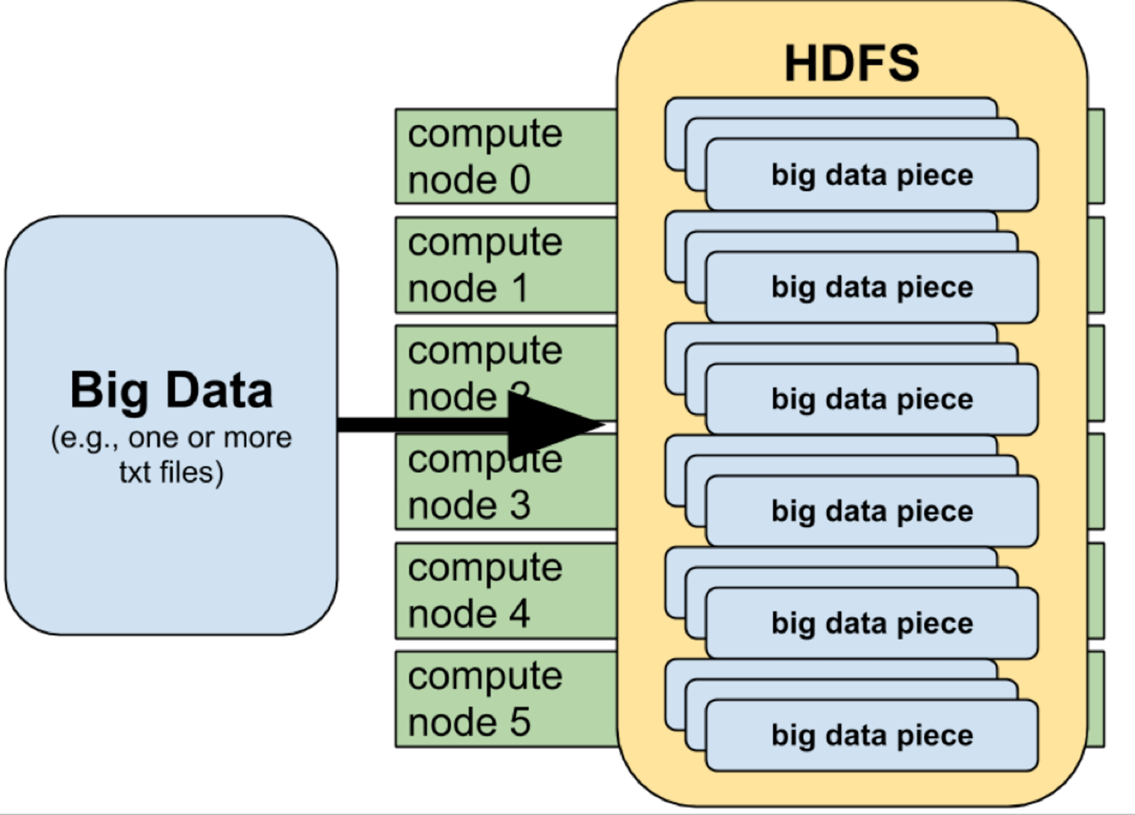
HDFS

Slide 28
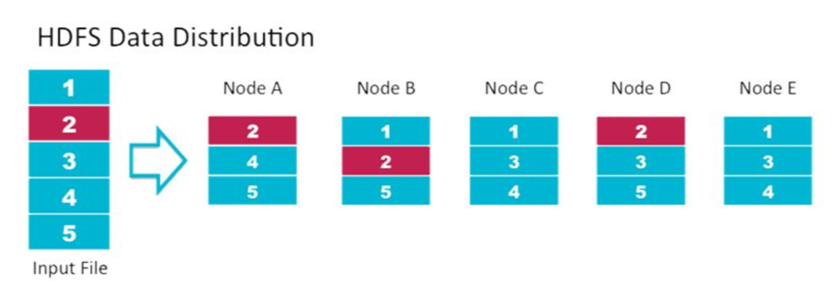
HDFS

Slide 29
Hadoop Architecture
Hadoop MapReduce
Single master node, many worker nodes
Client submits a job to master node
Master splits each job into tasks (map/reduce), and assigns tasks to worker nodes
Hadoop Distributed File System (HDFS)
Single name node, many data nodes
Files stored as large, fixed-size (e.g. 64MB) blocks
HDFS typically holds map input and reduce output

Slide 30
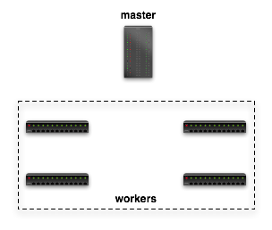

Dataflow in Hadoop
Submit job
map
schedule
reduce
map
reduce

Slide 31
Dataflow in Hadoop
Read
Input File
map
reduce
Block 1
HDFS
Block 2
map
reduce

Slide 32
Dataflow in Hadoop
map
Local FS
reduce
map
Local FS
reduce

Slide 33
Dataflow in Hadoop
Write Final Answer
reduce
HDFS
reduce

Slide 34
Basic MapReduce Execution
Your first Hadoop program
Submit your job
hadoop jar hadoop-examples.jar wordcount target output_folder
hadoop jar hadoop-examples.jar wordcount target myoutput
Check your result by
hadoop fs –cat myoutput/part-r-00000
See the job progress at
http://140.120.182.143:3000/cluster

Slide 35
Compile your hadoop program (1)
0. Download WordCount.java from our FTP site
javac -classpath hadoop-*-core.jar -d MyJava WordCount.java
jar -cvf wordcount.jar -C MyJava .
bin/hadoop jar wordcount.jar WordCount input/ output/

Slide 36
Compile your hadoop program (2)
0. Download WordCount.java
Download build.xml
Create a source folder called src
mv WordCount.java src/WordCount.java
ant and done (get output.jar) !
hadoop jar output.jar WordCount input output
https://github.com/UDICatNCHU/hadoop_tutorial

Slide 37
MapReduce Programming Model

Slide 38
Dataflow in Hadoop
Submit job
map
schedule
reduce
map
reduce

Slide 39
Dataflow in Hadoop
Read
Input File
map
reduce
Block 1
HDFS
Block 2
map
reduce

Slide 40
Dataflow in Hadoop
map
Local FS
reduce
map
Local FS
reduce

Slide 41
Dataflow in Hadoop
Write Final Answer
reduce
HDFS
reduce

Slide 42
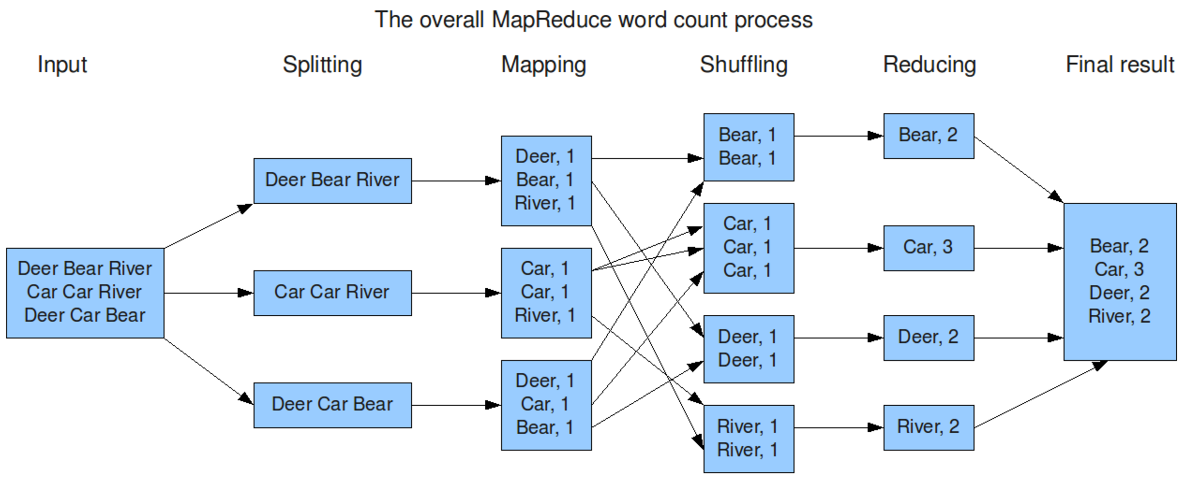
Word Count Example
As a programmer, you just only to focus ….

Slide 43
1. MapReduce Key-Value Programming Model
2. MapReduce Key-Value Programming Model
3. MapReduce Key-Value Programming Model
1. Key-Value Programming Model
2. Key-Value Programming Model
3. Key-Value Programming Model

Slide 44
MapReduce Programming Model
You write two functions, Map and Reduce.
They each have a special form (key-value pairs).
Map(String docid, String text):
for each word w in text:
Emit(w, 1);
Reduce(String term, Iterator<Int> values):
int sum = 0;
for each v in values:
sum += v;
Emit(term, sum);

Slide 45
MapReduce Programming Model
Data type: key-value records
Map function:
(K_{in}, V_{in}) ➔ list(K_{inter}, V_{inter})
Reduce function:
(K_{inter}, list(V_{inter})) ➔ list(K_{out}, V_{out})
All values with the same key are sent to the same reducer

Slide 46
MapReduce Programming Model: Word Count
Map(String docid, String text):
for each word w in text:
Emit(w, 1);
Reduce(String term, Iterator<Int> values):
int sum = 0;
for each v in values:
sum += v;
Emit(term, Sum);

Slide 47
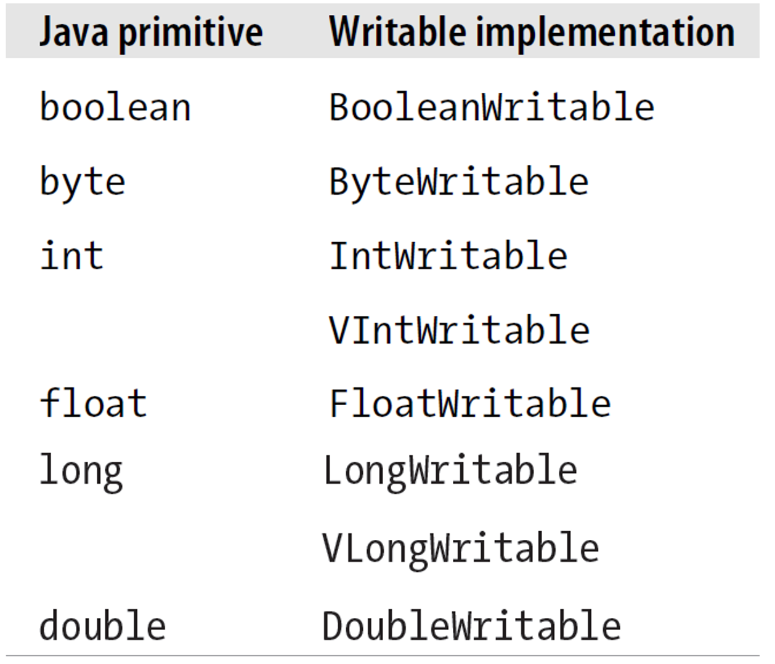
Before divining into Hadoop codes, Let’s pay attention on the following things
Hadoop v.s. Java Primitive Type
Writable
New IntWritable(100) vs. int = 100
Hadoop Context Object
context.write()
Hadoop I/O Controlling
Key, Value

Slide 48
Word Count in Java
public static void main(String[] args) throws Exception {
Configuration conf = new Configuration();
Job job = new Job(conf, "wordcount");
job.setOutputKeyClass(Text.class);
job.setOutputValueClass(IntWritable.class);
job.setMapperClass(Map.class);
job.setReducerClass(Reduce.class);
job.setInputFormatClass(TextInputFormat.class);
job.setOutputFormatClass(TextOutputFormat.class);
FileInputFormat.addInputPath(job, new Path(args[0]));
FileOutputFormat.setOutputPath(job, new Path(args[1]));
job.waitForCompletion(true);
}

Slide 49
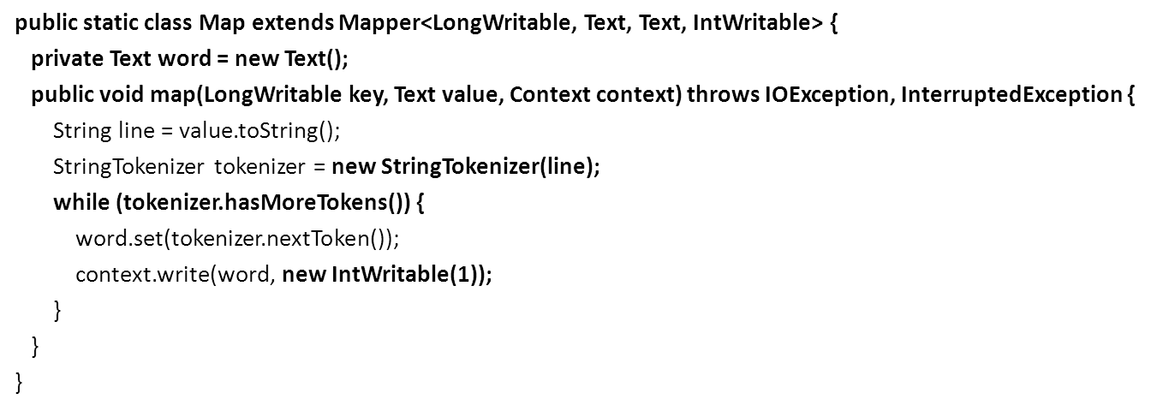
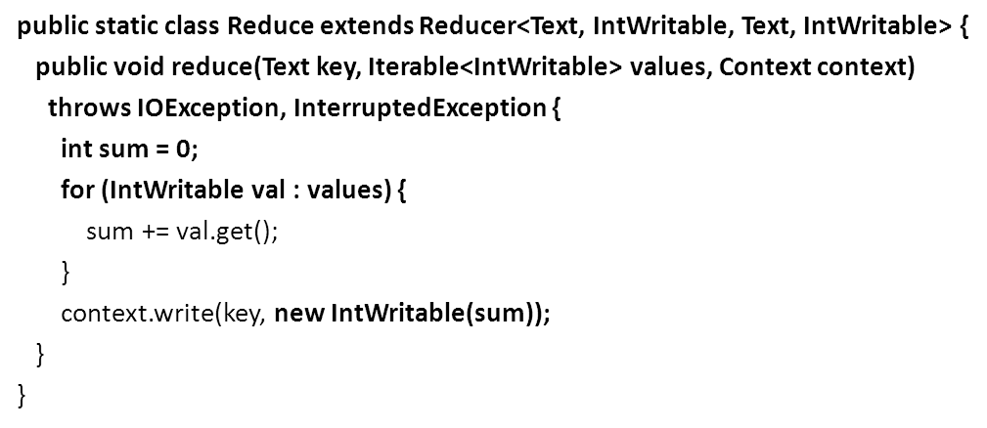

Slide 50
public static void main(String[] args) throws Exception {
Configuration conf = new Configuration();
Job job = new Job(conf, "wordcount");
job.setOutputKeyClass(Text.class);
job.setOutputValueClass(IntWritable.class);
job.setMapperClass(Map.class);
job.setReducerClass(Reduce.class);
job.setJarByClass(WordCount.class);
job.setInputFormatClass(TextInputFormat.class);
job.setOutputFormatClass(TextOutputFormat.class);
FileInputFormat.addInputPath(job, new Path(args[0]));
FileOutputFormat.setOutputPath(job, new Path(args[1]));
job.waitForCompletion(true);
}
TextOutputFormat
Read
Input File
TextInputFormat
Write
Output File
Map
Reduce
k
k
k
k
HDFS
HDFS
v
v
v
v

Slide 51
public static class Map extends Mapper<LongWritable, Text, Text, IntWritable> {
public void map(LongWritable key, Text value, Context context) {
String line = value.toString();
StringTokenizer tokenizer = new StringTokenizer(line);
while (tokenizer.hasMoreTokens()) {
String token = tokenizer.nextToken();
context.write(new Text(token), new IntWritable(1));
}
}
}
Test.txt
變數value的內容
各位 友邦 的 元首 與 貴賓 、 各國 駐台 使節 及 代表 、 現場 的 好 朋友 ， 全體 國人 同胞 ， 大家 好 。 感謝 與 承擔 就 在 剛剛 ， 我 和 陳建仁 已經 在 總統府 裡面 ， 正式 宣誓 就任 中華民國 第十四 任 總統 與 副 總統 。 我們 要 感謝 這塊 土地 對 我們 的 栽培 ， 感謝 人民 對 我們 的 信任 ， 以及 ， 最 重要 的 ， 感謝 這個 國家 的 民主 機制 ， 讓 我們 透過 和平 的 選舉 過程 ， 實現 第三次 政黨 輪替 ， 並且 克服 種種 不 確定 因素 ， 順利 渡過 長達 四個 月 的 交接 期 ， 完成 政權 和平 移轉 。
各位 友邦 的 元首 與 貴賓
context.write(new Text(“各位”), new intWritable(1));
context.write(new Text(“友邦”), new intWritable(1));
context.write(new Text(“的”), new intWritable(1));
context.write(new Text(“元首”), new intWritable(1));
：

Slide 52
Dataflow in Hadoop
Submit job
map
schedule
reduce
map
reduce

Slide 53
Dataflow in Hadoop
Read
Input File
map
reduce
Block 1
HDFS
各位 友邦 的 元首 與 貴賓 、 各國 駐台 使節 及 代表 、 現場 的 好 朋友 ， 全體 國人 同胞 ， 大家 好 。 感謝 與 承擔 就 在 剛剛 ， 我 和 陳建仁 已經 在 總統府 裡面 ， 正式 宣誓 就任 中華民國 第十四 任 總統 與 副 總統 。 我們 要 感謝 這塊 土地 對 我們 的 栽培 ， 感謝 人民 對 我們 的 信任 ， 以及 …
Block 2
map
reduce

Slide 54
Dataflow in Hadoop
各位 友邦 的 元首 與 貴賓 、 各國 駐台 使節 及 代表 、 現場 的 好 朋友 ， 全體 國人 同胞 ， 大家 好 。 感謝 與 承擔 就 在 剛剛 ， 我 和 陳建仁 已經 在 總統府 裡面
Read
Input File
map
reduce
Block 1
HDFS
Block 2
map
reduce
正式 宣誓 就任 中華民國 第十四 任 總統 與 副 總統 。 我們 要 感謝 這塊 土地 對 我們 的 栽培 ， 感謝 人民 對 我們 的 信任 ， 以及 …

Slide 55
Dataflow in Hadoop
(的,1)
(的,1)
map
(我們,1)
reduce
Local FS
map
Local FS
reduce
(的,1)
(的,1)
(的,1)
(我們,1)

Slide 56
Dataflow in Hadoop
(的,[1,1,1,1,1])
map
Local FS
reduce
map
Local FS
reduce
(我們,[1,1])

Slide 57
Dataflow in Hadoop
Write Final Answer
reduce
HDFS
reduce

Slide 58
的: 1, 1, 1, 1, 1
我們: 1, 1, 1
各位: 1
的: 1, 1, 1, 1, 1
Key, Value List
1+1+1+1+1
Context.write(的, 5);

Slide 59
MapReduce Programming Model
Data type: key-value records
Map function:
(K_{in}, V_{in}) ➔ list(K_{inter}, V_{inter})
Reduce function:
(K_{inter}, list(V_{inter})) ➔ list(K_{out}, V_{out})

Slide 60
The Sum
Hint: You may need:
Integer.parseInt(“12”))

Slide 61
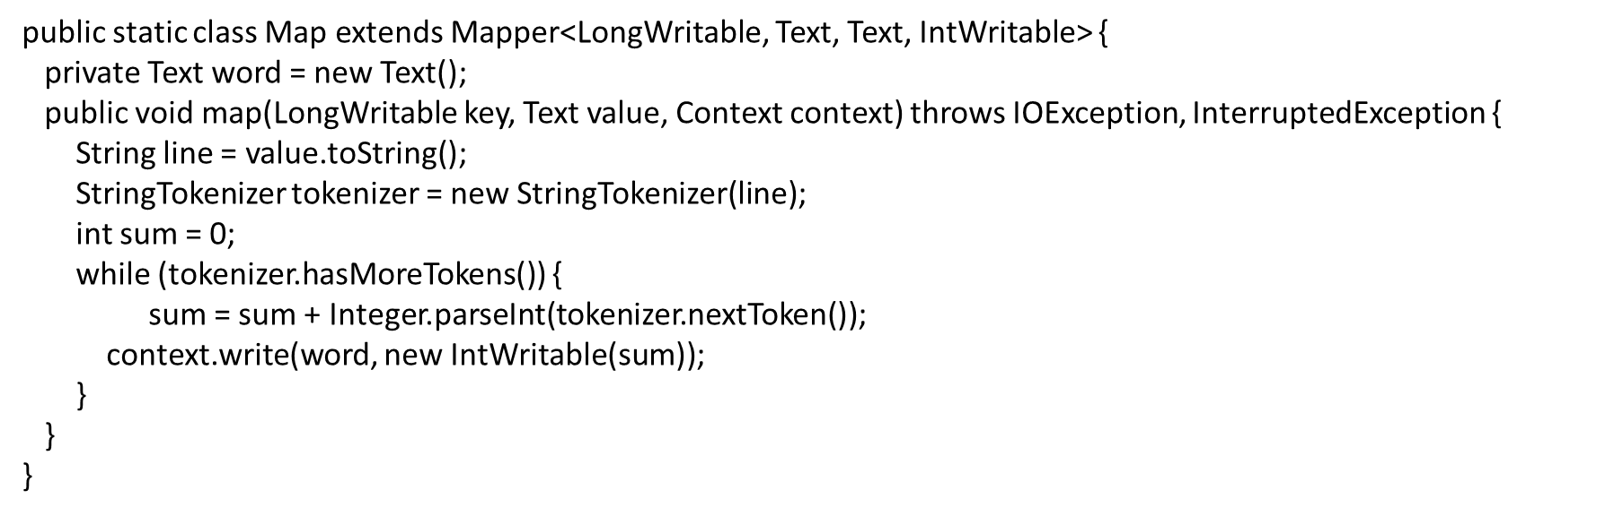
Ep.txt
10 31
55
599
99 11
10 31
Sum = 0+10
Sum = 10+31 = 41
context.write(word, new IntWritable(41));

Slide 62
null: 41, 66, 614, 110
null : 41, 66, 614, 110
Key, Value List
41+66+614+110
Context.write(null, 831);

Slide 63
Top-20 ?

Slide 64
Distinct Count ?

Slide 65
Assignment
Please Compute Max Value in EP.txt

Slide 66
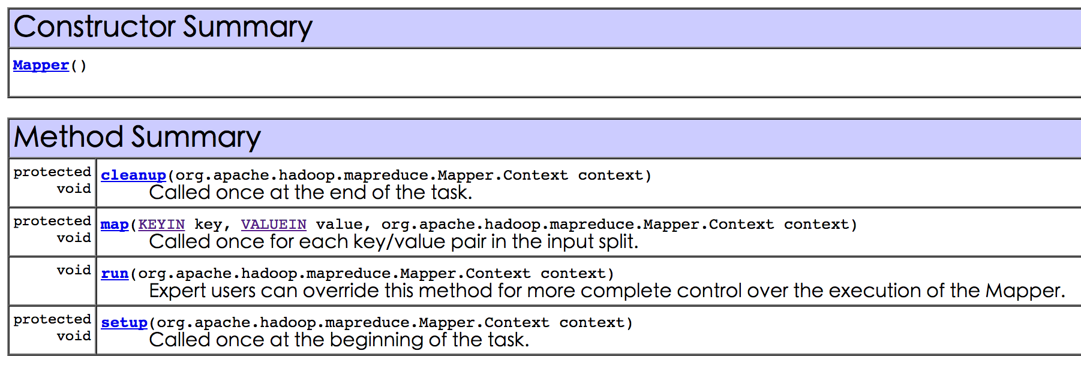
Mapper Available Method

Slide 67
MapReduce Programming Model
Data type: key-value records
Map function:
(K_{in}, V_{in}) ➔ list(K_{inter}, V_{inter})
Reduce function:
(K_{inter}, list(V_{inter})) ➔ list(K_{out}, V_{out})

Slide 68
Reviews

Slide 69

MapReduce
Why MapReduce is proposed ?
A simplified platform for programmer or scientists with non-parallel background
Hadoop: an open source implementation for MapReduce

Slide 70
What is MapReduce?
Data-parallel programming model for clusters of commodity machines
Pioneered by Google
Processes 20 PB of data per day
Popularized by open-source Hadoop project
Used by Yahoo!, Facebook, Amazon, …

Slide 71
Map-Reduce
You write two functions, Map and Reduce.
They each have a special form (key-value pairs).

Slide 72
Dataflow in Hadoop
Submit job
map
schedule
reduce
map
reduce

Slide 73
Dataflow in Hadoop
Read
Input File
map
reduce
Block 1
HDFS
Block 2
map
reduce

Slide 74
Dataflow in Hadoop
map
Local FS
reduce
map
Local FS
reduce

Slide 75
Dataflow in Hadoop
Write Final Answer
reduce
HDFS
reduce

Slide 76
MapReduce Programming Model
Data type: key-value records
Map function:
(K_{in}, V_{in}) ➔ list(K_{inter}, V_{inter})
Reduce function:
(K_{inter}, list(V_{inter})) ➔ list(K_{out}, V_{out})
All values with the same key are sent to the same reducer

Slide 77
“Hello World”: Word Count
Map(String docid, String text):
for each word w in text:
Emit(w, 1);
Reduce(String term, Iterator<Int> values):
int sum = 0;
for each v in values:
sum += v;
Emit(term, sum);

Slide 78
Word Count Execution
Input
Map
Shuffle & Sort
Reduce
Output
the, 1
brown, 1
fox, 1
the quick
brown fox
Map
brown, 2
fox, 2
how, 1
now, 1
the, 3
Reduce
the, 1
fox, 1
the, 1
the fox ate
the mouse
Map
quick, 1
how, 1
now, 1
brown, 1
ate, 1
cow, 1
mouse, 1
quick, 1
ate, 1
mouse, 1
Reduce
how now
brown cow
Map
cow, 1

Slide 79
如何計算Ep.txt中的平均值？

Slide 80
Solution
public class Average {
public static class Map extends Mapper<LongWritable, Text, Text, MapWritable> {
private Text word = new Text();
private MapWritable arry = new MapWritable();
public void map(LongWritable key, Text value, Context context) throws IOException, InterruptedException {
String line = value.toString();
StringTokenizer tokenizer = new StringTokenizer(line);
int count = 0;
int sum = 0;
while (tokenizer.hasMoreTokens()) {
count ++;
sum = sum + Integer.parseInt(tokenizer.nextToken());
}
arry.put(new IntWritable(0), new IntWritable(count));
arry.put(new IntWritable(1), new IntWritable(sum));
context.write(word, arry);
}
}

Slide 81
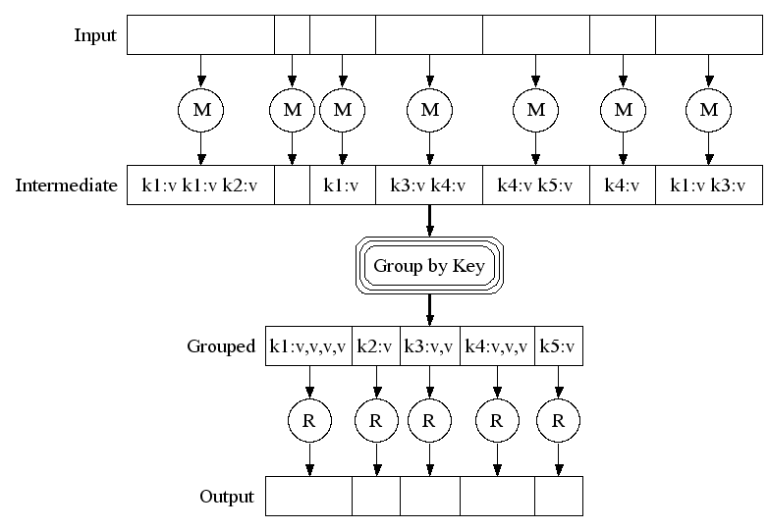
MapReduce Concept
10 31
55
599
99 11
(null,[2, 41])
(null,[2, 66])
(null,[2, 614])
(null,[2, 110])
null: [2, 41], [2,66]
[2, 614], [2, 110]

Slide 82
public static class Reduce extends Reducer<Text, MapWritable, Text, DoubleWritable> {
public void reduce(Text key, Iterable<MapWritable> arry, Context context) throws IOException, InterruptedException {
int sum = 0;
int count = 0;
for (MapWritable ar : arry) {
count = count + ((IntWritable)ar.get(new IntWritable(0))).get();
sum = sum + ((IntWritable)ar.get(new IntWritable(1))).get();
}
context.write(key, new DoubleWritable(sum/count));
}
}
public static void main(String[] args) throws Exception {
Configuration conf = new Configuration();
Job job = new Job(conf, "Avg");
job.setMapperClass(Map.class);
job.setReducerClass(Reduce.class);
job.setMapOutputKeyClass(Text.class);
job.setMapOutputValueClass(MapWritable.class);
job.setOutputKeyClass(Text.class);
job.setOutputValueClass(DoubleWritable.class);
job.setJarByClass(Average.class);
job.setInputFormatClass(TextInputFormat.class);
job.setOutputFormatClass(TextOutputFormat.class);
FileInputFormat.addInputPath(job, new Path(args[0]));
FileOutputFormat.setOutputPath(job, new Path(args[1]));
job.waitForCompletion(true);
}
}

Slide 83
MapReduce Programming Model
Data type: key-value records
Map function:
(K_{in}, V_{in}) ➔ list(K_{inter}, V_{inter})
Reduce function:
(K_{inter}, list(V_{inter})) ➔ list(K_{out}, V_{out})
All values with the same key are sent to the same reducer

Slide 84
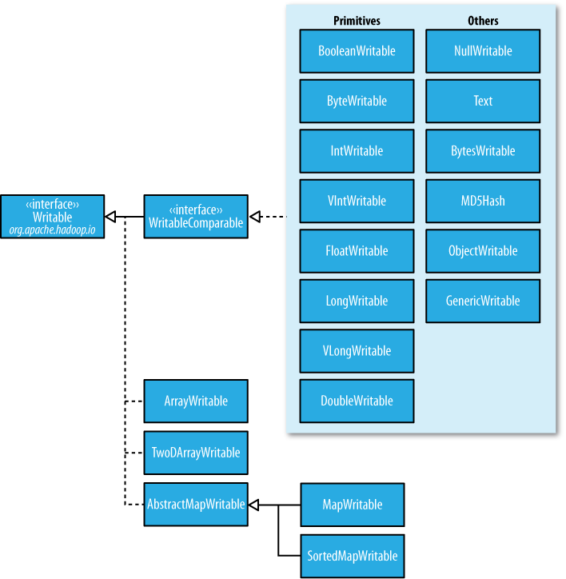

Slide 85


Slide 86
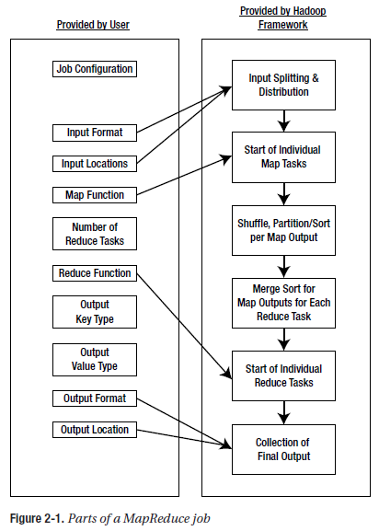
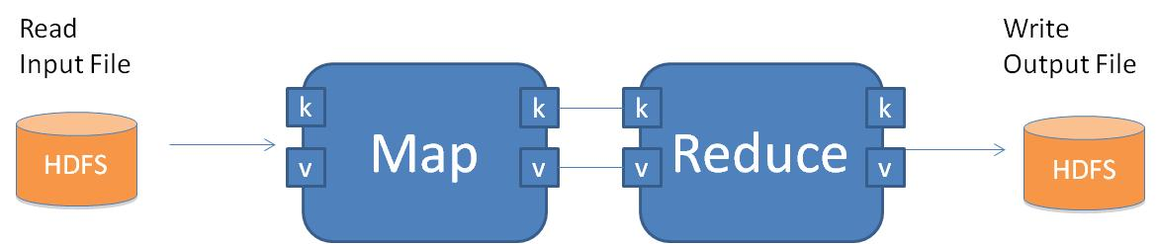
MapReduce Job
public static void main(String[] args) throws Exception {
Configuration conf = new Configuration();
Job job = new Job(conf, "wordcount");
job.setOutputKeyClass(Text.class);
job.setOutputValueClass(IntWritable.class);
job.setMapperClass(Map.class);
job.setReducerClass(Reduce.class);
job.setJarByClass(WordCount.class);
job.setInputFormatClass(TextInputFormat.class);
job.setOutputFormatClass(TextOutputFormat.class);
FileInputFormat.addInputPath(job, new Path(args[0]));
FileOutputFormat.setOutputPath(job, new Path(args[1]));
job.waitForCompletion(true); //工作執行！
}

Slide 87
public static void main(String[] args) throws Exception {
Configuration conf = new Configuration();
Job job = new Job(conf, "wordcount");
job.setOutputKeyClass(Text.class);
job.setOutputValueClass(IntWritable.class);
job.setMapperClass(Map.class);
job.setReducerClass(Reduce.class);
job.setJarByClass(WordCount.class);
job.setInputFormatClass(TextInputFormat.class);
job.setOutputFormatClass(TextOutputFormat.class);
FileInputFormat.addInputPath(job, new Path(args[0]));
FileOutputFormat.setOutputPath(job, new Path(args[1]));
job.waitForCompletion(true);
}
TextOutputFormat
Read
Input File
TextInputFormat
Write
Output File
Map
Reduce
k
k
k
k
HDFS
HDFS
v
v
v
v

Slide 88

The Challenge Sort the words according to their counts

Slide 89
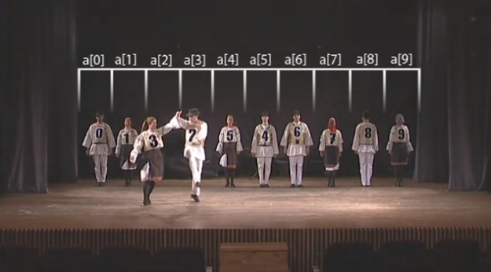
Challenge
Sorting?
How to perform sorting using MapReduce?

Slide 90
public static void main(String[] args) throws Exception {
Configuration conf = new Configuration();
Job job = new Job(conf, "wordcount");
job.setOutputKeyClass(Text.class);
job.setOutputValueClass(IntWritable.class);
job.setMapperClass(Map.class);
job.setReducerClass(Reduce.class);
job.setJarByClass(WordCount.class);
job.setInputFormatClass(TextInputFormat.class);
job.setOutputFormatClass(TextOutputFormat.class);
FileInputFormat.addInputPath(job, new Path(args[0]));
FileOutputFormat.setOutputPath(job, new Path(args[1]));
job.waitForCompletion(true); //工作執行！
}
Read
Input File
Write
Output File
Map
Reduce
k
k
k
k
HDFS
HDFS
v
v
v
v

Slide 91
:
17 有
18 區域
18 就是
18 我
20 發展
21 社會
21 民主
22 也
24 讓
24 會
25 經濟
25 這個
25 要
27 新政府
27 是
29 一個
31 和
32 國家
33 在
37 與
39 台灣
59 、
86 我們
159 。
292 的
336 ，
各位 友邦 的 元首 與 貴賓 、 各國 駐台 使節 及 代表 、 現場 的 好 朋友 ， 全體 國人 同胞 ， 大家 好 。
感謝 與 承擔 就 在 剛剛 ， 我 和 陳建仁 已經 在 總統府 裡面 ， 正式 宣誓 就任 中華民國 第十四 任
總統 與 副 總統 。 我們 要 感謝 這塊 土地 對 我們 的 栽培 ， 感謝 人民 對 我們 的 信任 ，
以及 ， 最 重要 的 ， 感謝 這個 國家 的 民主 機制 ， 讓 我們 透過 和平 的 選舉 過程 ， 實現 第三次 政黨 輪替 ，
並且 克服 種種 不 確定 因素 ， 順利 渡過 長達 四個 月 的 交接 期 ， 完成 政權 和平 移轉 。 台灣 ，
再 一次 用 行動 告訴 世界 ， 作為 一群 民主 人 與 自由人 ， 我們 有 堅定 的 信念 ， 去 捍衛 民主自由 的 生活 方式 。
這段 旅程 ， 我們 每 一個 人 都 參與 其中 。 親愛 的 台灣

Slide 92
Read
Input File
Write
Output File
Map
Reduce
k
k
k
k
HDFS
HDFS
v
v
v
v
Write
Output File
Reduce
Map
k
k
k
k
HDFS
v
v
v
v
Read
output File
關於 2
關聯 1
關鍵 4
關鍵時刻 1
:
陳建仁 2
階層 1
階段 1
:
雙引擎 1
各位 友邦 的 元首 與 貴賓 、 各國 駐台 使節 及 代表 、 現場 的 好 朋友 ， 全體 國人 同胞 ， 大家 好 。
感謝 與 承擔 就 在 剛剛 ， 我 和 陳建仁 已經 在 總統府 裡面 ， 正式 宣誓 就任 中華民國 第十四 任
總統 與 副 總統 。 我們 要 感謝 這塊 土地 對 我們 的 栽培 ， 感謝 人民 對 我們 的 信任 ，
32 國家
33 在
37 與
39 台灣
59 、
86 我們
159 。
292 的
336 ，

Slide 93

public static void main(String[] args) throws Exception {
Configuration conf = new Configuration();
Job job = new Job(conf, "wordcount");
job.setOutputKeyClass(Text.class);
job.setOutputValueClass(IntWritable.class);
job.setMapperClass(Map.class);
job.setReducerClass(Reduce.class);
job.setJarByClass(WordCount.class);
job.setInputFormatClass(TextInputFormat.class);
job.setOutputFormatClass(TextOutputFormat.class);
FileInputFormat.addInputPath(job, new Path(args[0]));
FileOutputFormat.setOutputPath(job, new Path(args[1]));
job.waitForCompletion(true);
}
Job1

Slide 94
This assignment will let you know…
Iterative Programming Model

Slide 95
Further Resources
GridEngine User's Guide: http://rc.usf.edu/trac/doc/wiki/gridEngineUsers
GridEngine Hadoop Submission Script: http://rc.usf.edu/trac/doc/wiki/Hadoop
Hadoop Tutorial: http://developer.yahoo.com/hadoop/tutorial/module1.html
Hadoop Streaming: http://hadoop.apache.org/common/docs/r0.15.2/streaming.html
Hadoop API: http://hadoop.apache.org/common/docs/current/api
HDFS Commands Reference: http://hadoop.apache.org/hdfs/docs/current/file_system_shell.html
Textbooks:
Tom White, Hadoop: the Definitive Guide, Third Edition, OREILLY.
Jimmy Lin, Data-Intensive Text Processing with MapReduce, Morgan & Claypool Publishers

Slide 96
Join
Classic MapReduce Algorithm

Slide 97
MapReduce Join: Running Example
table x
key
value
key
valuelist
A | B
1 | ab
1 | cd
4 | ef
output
1
x | ab
x | cd
shuffle()
x | ab
y | b
x | cd
map()
1
1
A | B | C
1 | ab | b
1 | cd | b
4 | ef | c
4
x | ef
reduce()
join key
table y
key
value
2
y | d
tag
A | C
1 | b
2 | d
4 | c
1
y | b
x | ef
y | c
map()
4
2
y | d
4
y | c
Notes:
This is an example.

Slide 98
Matrix Operation
Classic MapReduce Algorithm

Slide 99
Matrix Representation
Represent matrix as list of nonzero entries
⟨row, col, value⟩
A
<1, 1, 10>
<1, 3, 20>
<2, 2, 30>
<2, 3, 40>
<3, 1, 50>
<3, 2, 60>
<3, 3, 70>
10
20
30
40
50
60
70

Slide 100
Matrix Operations
Matrix
Matrix Transpose ?
Read <row, col, value>
Emit <col, row, value>
Matrix Addition ?
Mapper emits <row, col> as key
Reducer sums over the value lists
Matrix Multiplication ?
A
B
10
20
10
20
30
40
30
40
50
60
70
50
60
70
<1, 1, 10>
<1, 3, 20>
<2, 2, 30>
<2, 3, 40>
<3, 1, 50>
<3, 2, 60>
<3, 3, 70>
<1, 1, 10>
<1, 3, 20>
<2, 2, 30>
<2, 3, 40>
<3, 1, 50>
<3, 2, 60>
<3, 3, 70>

Slide 101
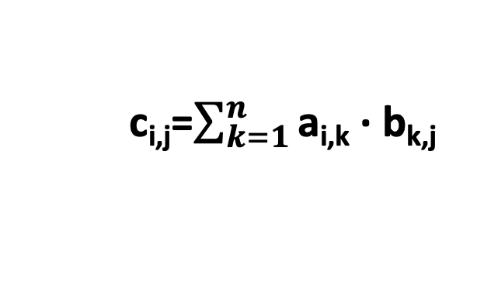
Matrix Multiplication
A
B
C
10
20
-1
-10
-80
x
30
40
-2
-3
=
-60
-250
50
60
70
-4
-170
-460
<1, 1, 10>
<1, 3, 20>
<2, 2, 30>
<2, 3, 40>
<3, 1, 50>
<3, 2, 60>
<3, 3, 70>
<1, 1, -1>
<2, 1, -2>
<2, 2, -3>
<3, 2, -4>
c_{i,j}=$\sum_{k=1}^{n}{\text{a}\text{i}\text{,}\text{k}\text{ · }\text{bk}\text{,}\text{j} }$

Slide 102
Phase 1 Map of Matrix Multiply
Key 1
<1, 1, 10, A>
<1, 3, 20, A>
<2, 2, 30, A>
<2, 3, 40, A>
<3, 1, 50, A>
<3, 2, 60, A>
<3, 3, 70, A>
<1, 1, 10, A>
<3, 1, 50, A>
<1, 1, -1, B>
Key 2
<2, 2, 30, A>
<3, 2, 60, A>
<2, 1, -2, B>
<2, 2, -3, B>
<1, 1, -1, B>
<2, 1, -2, B>
<2, 2, -3, B>
<3, 2, -4, B>
Key 3
<1, 3, 20, A>
<2, 3, 40, A>
<3, 3, 70, A>
<3, 2, -4, B>
Group values a_{i,k} and b_{k,j} according to key k

Slide 103
Phase 1 “Reduce” of Matrix Multiply
Key 1
<1, 1, -10, AB>
<3, 1, -50, AB>
<1, 1, 10, A>
<3, 1, 50, A>
<1, 1, -1, B>
<2, 1, -60, AB>
<2, 2, -90, AB>
<3, 1, -120, AB>
<3, 2, -180, AB>
Key 2
<2, 2, 30, A>
<3, 2, 60, A>
<2, 1, -2, B>
<2, 2, -3, B>
Key 3
<1, 2, -80, AB>
<2, 2, -160, AB>
<3, 2, -280, AB>
<1, 3, 20, A>
<2, 3, 40, A>
<3, 3, 70, A>
<3, 2, -4, B>
Generate all products a_{i,k} · b_{k,j}

Slide 104
Phase 2 Map of Matrix Multiply
<1, 1, -10, AB>
<3, 1, -50, AB>
<1, 1, -10, AB>
<1, 2, -80, AB>
<2, 1, -60, AB>
<2, 2, -250, AB>
<3, 1, -170, AB >
<3, 2, -460, AB>
<2, 1, -60, AB>
<2, 2, -90, AB>
<3, 1, -120, AB>
<3, 2, -180, AB>
C
<1, 2, -80, AB>
<2, 2, -160, AB>
<3, 2, -280, AB>
-10
-80
-60
-250
-170
-460
Group products a_{i,k} · b_{k,j} with matching values of i and j

Slide 105
Computing Matrix Product
Represent matrix as list of nonzero entries
⟨row, col, value, matrixID⟩
Strategy
Phase 1: Compute all products a_{i,k} · b_{k,j}
Phase 2: Sum products for each entry i,j
Each phase involves a Map/Reduce

Slide 106
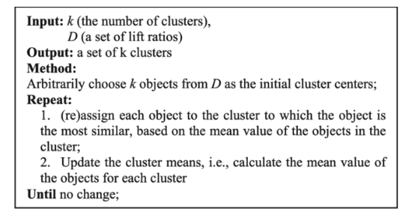
K-means

Slide 107
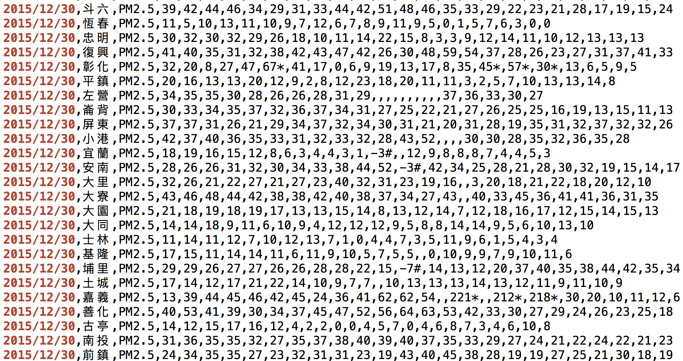
PM25 Data
Terminology you need to know: Object, Features, Distance between Objects

Slide 108
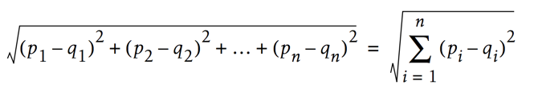
Distance between Objects

Slide 109


Slide 110
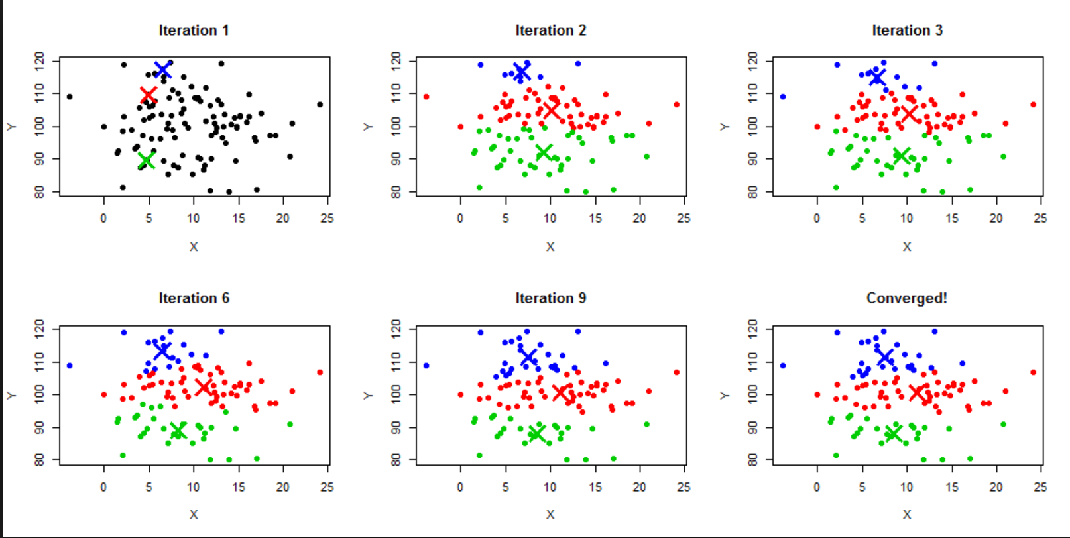
K-Mean Algorithm Running Example

Slide 111
K-Mean Visualization
http://stanford.edu/class/ee103/visualizations/kmeans/kmeans.html

Slide 112

K-Means with Hadoop/MapReduce

Slide 113


Slide 114
Spark

Slide 115
MapReduce problems & potential solution
MapReduce problems:
Many problems aren’t easily described as map-reduce
Persistence to disk typically slower than in-memory work

Slide 116

Spark
“Resilient Distributed Datasets: A Fault-Tolerant Abstraction for In-Memory Cluster Computing” by Matei Zaharia et al
https://www.cs.berkeley.edu/~matei/papers/2012/nsdi_spark.pdf

Slide 117
Apache Spark
Processing engine; instead of just “map” and “reduce”, defines a large set of operations (transformations & actions)
In-memory Computation
Key construct: Resilient Distributed Dataset (RDD)

Slide 118
Gray sort competition: Winner Spark-based (previously MR)
 | Hadoop MR Record | Spark Record (2014)
Data Size | 102.5 TB | 100 TB
Elapsed Time | 72 mins | 23 mins
# Nodes | 2100 | 206
# Cores | 50400 physical | 6592 virtualized
Cluster disk throughput | 3150 GB/s (est.) | 618 GB/s
Network | dedicated data center, 10Gbps | virtualized (EC2) 10Gbps network
Sort rate | 1.42 TB/min | 4.27 TB/min
Sort rate/node | 0.67 GB/min | 20.7 GB/min
Spark-based
System
3x faster
with 1/10
# of nodes
Sort benchmark, Daytona Gray: sort of 100 TB of data (1 trillion records)

Slide 119
Spark vs. Hadoop MapReduce
Performance: Spark normally faster but with caveats
Spark can process data in-memory; Hadoop MapReduce persists back to the disk after a map or reduce action
Spark generally outperforms MapReduce, but it often needs lots of memory to do well; if there are other resource-demanding services or can’t fit in memory, Spark degrades
MapReduce easily runs alongside other services with minor performance differences, & works well with the 1-pass jobs it was designed for
Ease of use: Spark is easier to program
Data processing: Spark more general
Maturity: Spark maturing, Hadoop MapReduce mature

Slide 120
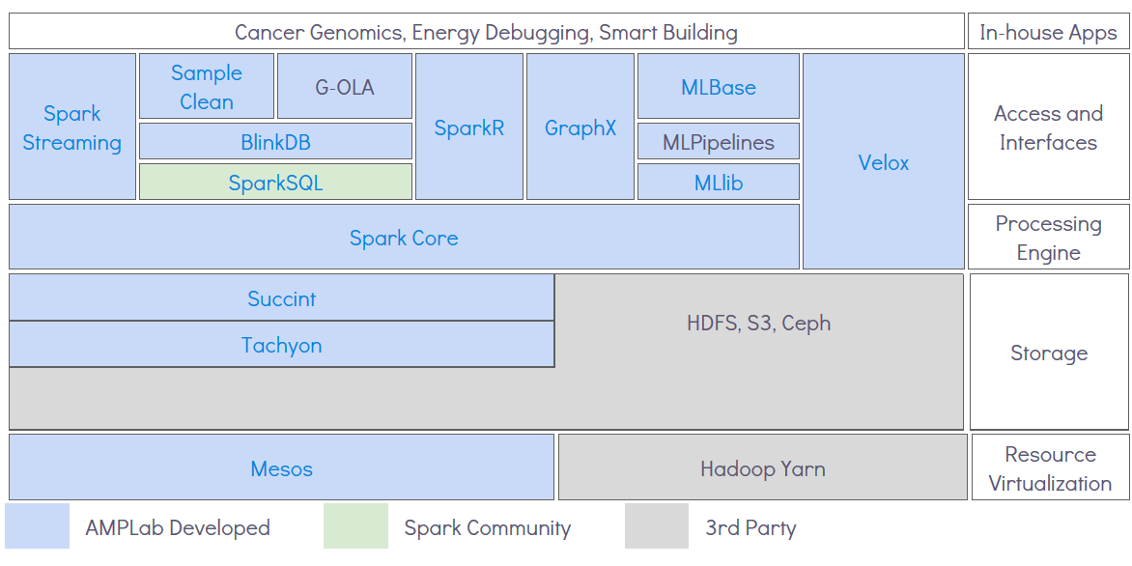
AMPLab’s Berkeley Data Analytics Stack (BDAS)
Don’t need to memorize this figure – the point is to know
that components can be combined to solve big data problems

Slide 121
Apache Spark: Libraries “on top” of core that come with it
Spark SQL
Spark Streaming – stream processing of live datastreams
MLlib - machine learning
GraphX – graph manipulation

Slide 122
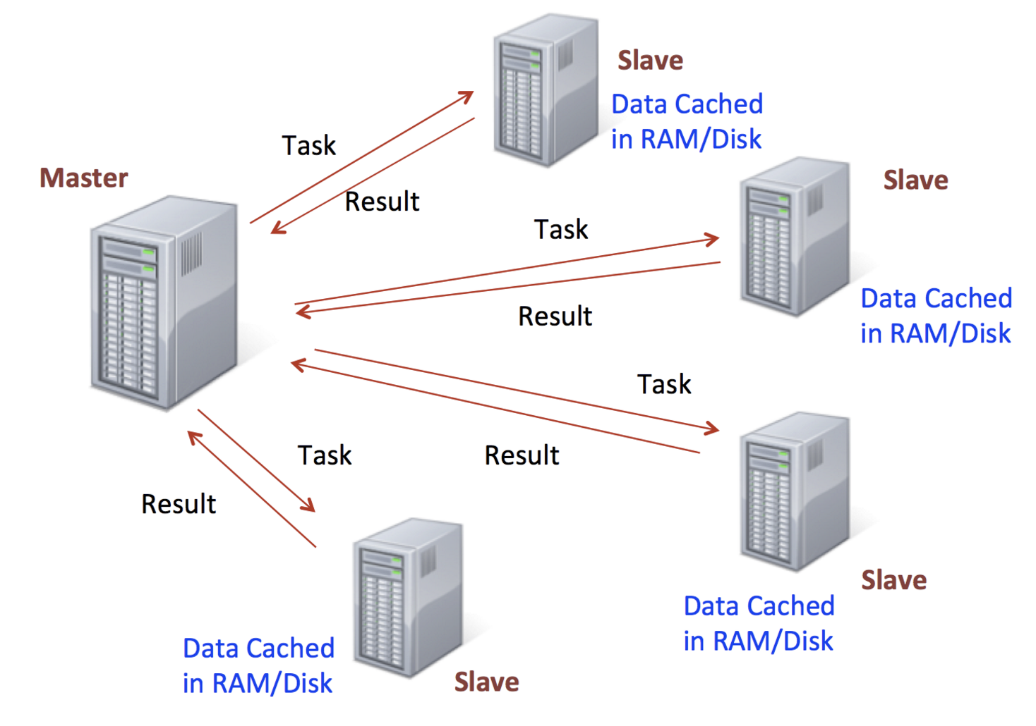

Slide 123
RDD (Resilient Distributed Data )

Slide 124
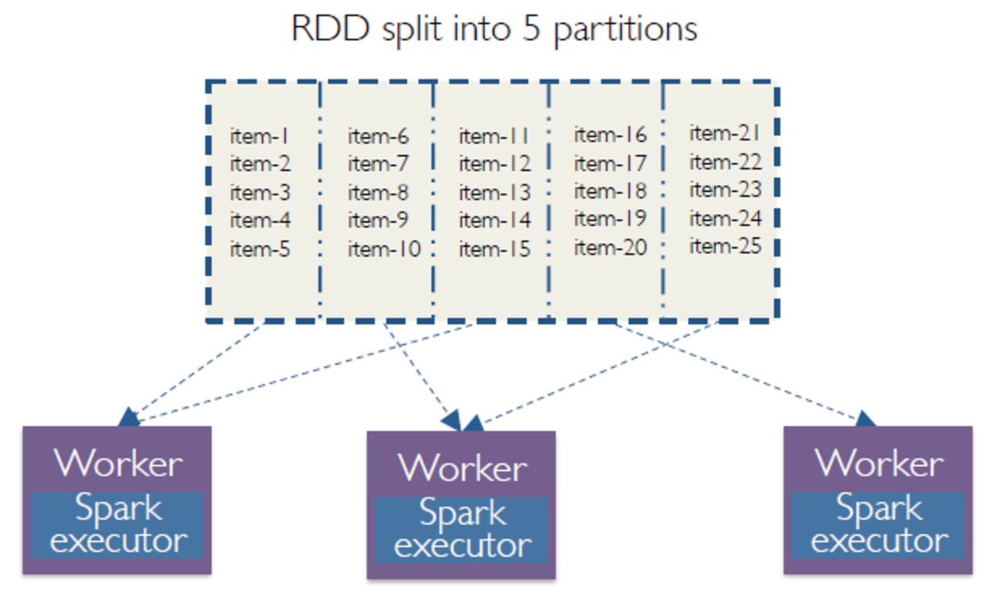
RDD overview

Slide 125
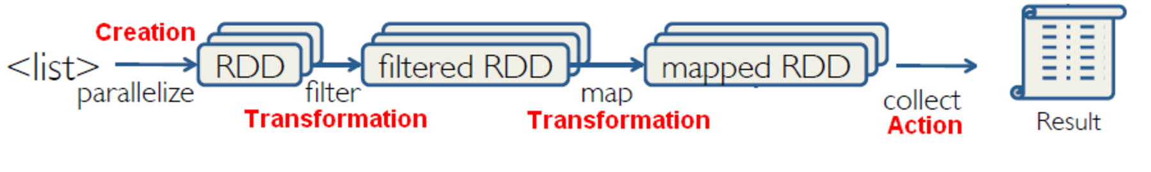
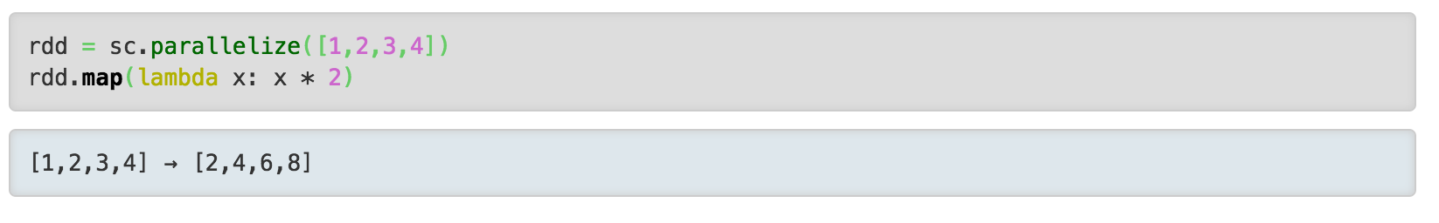
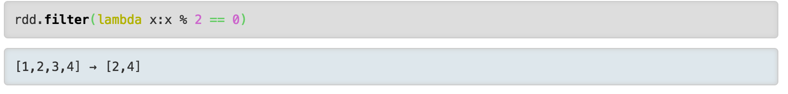
RDD, Transformation, Action
http://spark.apache.org/docs/1.1.1/api/python/pyspark.rdd.RDD-class.html

Slide 126
Sample Spark transformations
map(func): Return a new distributed dataset formed by passing each element of the source through a function func.
filter(func): Return a new dataset formed by selecting those elements of the source on which func returns true
union(otherDataset): Return a new dataset that contains the union of the elements in the source dataset and the argument.
intersection(otherDataset): Return a new RDD that contains the intersection of elements in the source dataset and the argument.
distinct([numTasks])): Return a new dataset that contains the distinct elements of the source dataset
join(otherDataset, [numTasks]): When called on datasets of type (K, V) and (K, W), returns a dataset of (K, (V, W)) pairs with all pairs of elements for each key. Outer joins are supported through leftOuterJoin, rightOuterJoin, and fullOuterJoin.

Slide 127
Sample Spark Actions
reduce(func): Aggregate the elements of the dataset using a function func (which takes two arguments and returns one). The function should be commutative and associative so that it can be computed correctly in parallel.
collect(): Return all the elements of the dataset as an array at the driver program. This is usually useful after a filter or other operation that returns a sufficiently small subset of the data.
count(): Return the number of elements in the dataset.
Remember: Actions cause calculations to be performed;
transformations just set things up (lazy evaluation)

Slide 128
Filter
Map

Slide 129
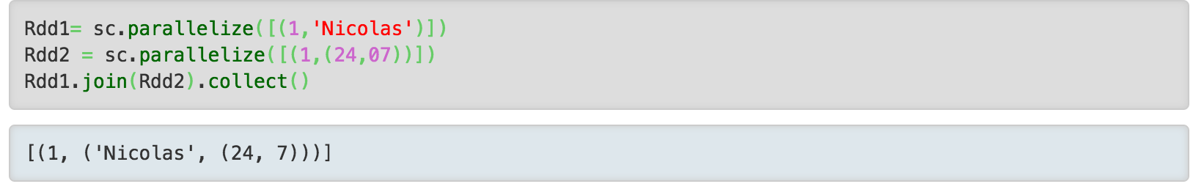
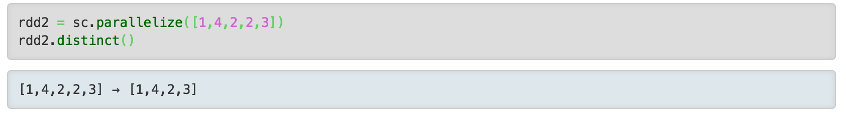
Distinct
Join

Slide 130
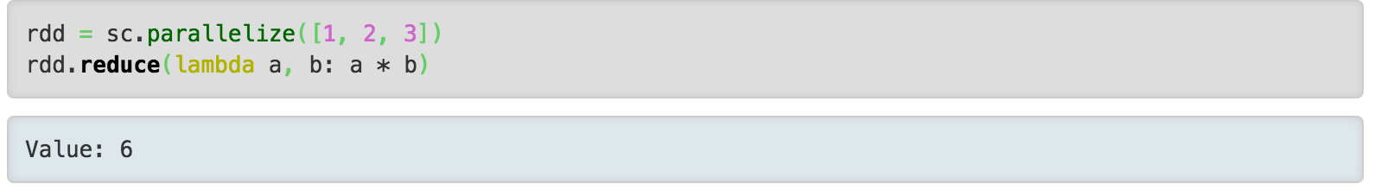
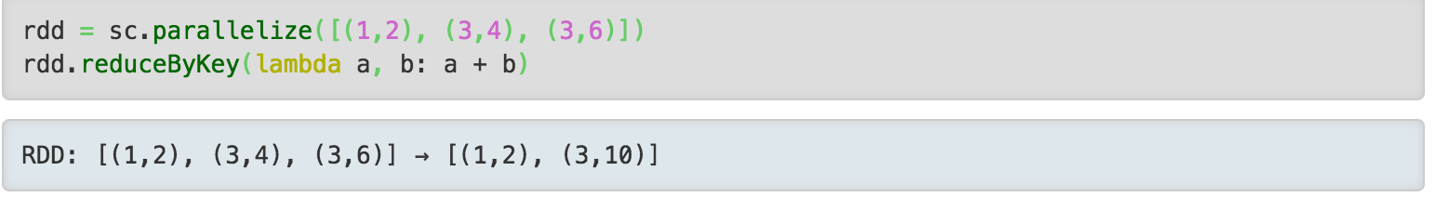
Reduce
ReducebyKey
http://gerardnico.com/wiki/spark/collect

Slide 131
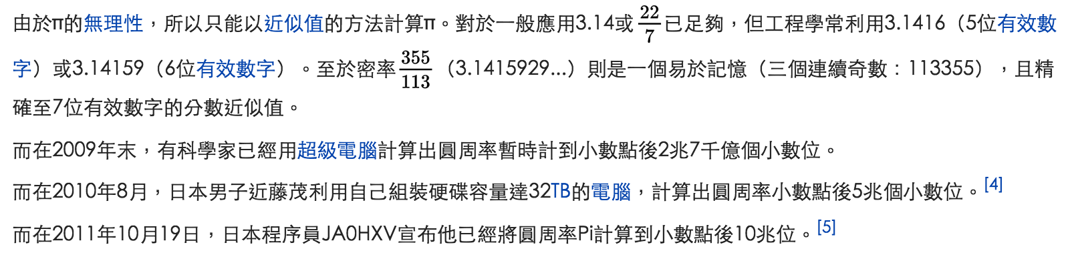
Pi Estimators

Slide 132
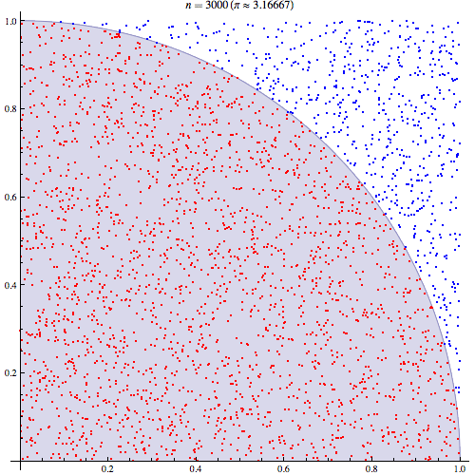

Pi Estimators

Slide 133
Spark example #1 (Python)
# Estimate π (compute-intensive task).
# Pick random points in the unit square ((0, 0) to (1,1)),
# See how many fall in the unit circle. The fraction should be π / 4
# Note that “parallelize” method creates an RDD
def sample(p):
x, y = random(), random()
return 1 if x*x + y*y < 1 else 0
count = spark.parallelize(xrange(0, NUM_SAMPLES)).map(sample) \
.reduce(lambda a, b: a + b)
print "Pi is roughly %f" % (4.0 * count / NUM_SAMPLES)

Slide 134
Common Operator
map()
reduce()
collect() → Hadoop fs -get datahdfs data
Parallarize()→ Hadoop fs -put data datahdfs
count()
reducebykey()
filter()
sample()

Slide 135
Colab Today
https://tinyurl.com/nchupm25
https://tinyurl.com/nchudataframe

Slide 136
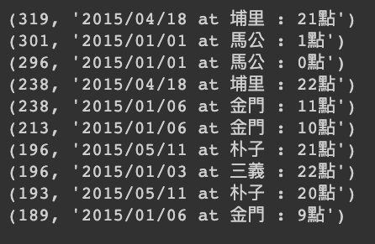
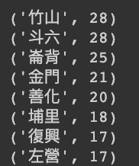
PM25分析目標
練習1: 求取2015年，大里測站每小時的平均pm25數值。
練習2：求取2015年，全國pm2.5最高的前十個工作站測點以及其日期。
練習3：請算算看2015全國哪個測站，紫爆天數最多？(當日平均值超過60紫爆)

